Slide 1
Greedy Algorithm
🟢Definition:
A Greedy Algorithm makes the best possible choice at each step, hoping to achieve a globally optimal solution.
It does not backtrack or reconsider previous choices.
🟢 Key Features: ✔ Locally optimal decisions lead to a globally optimal solution. ✔ Faster than brute-force or dynamic programming in many cases. ✔ Works well for optimization problems.
It makes optimal choice at each stage with hope of finding global optimal solution.

Slide 2
General Approach of Greedy Algorithm
1️⃣ Sort data based on the greedy condition
2️⃣ Pick the best option available at each step. 3️⃣ Repeat until constraints are met. 4️⃣ Get the final solution (may or may not be optimal).
Example: Coin Change Problem → Always take the largest coin first.

Slide 3
Two important questions
Do you need the best option at the moment for the problem ?
Do you need optimal solution (minimum /maximum ) ?
Example : Imagine you are a cashier and need to give a customer change using least number of coins for value of 73 ? [ 50,25,10,5,1]
Goal :- To maximize the number of coins to change
Iteration 1 : 73 - 50 = 23
Iteration 2 : 23 - 10 = 13
Iteration 3 : 13 - 10 = 3
Iteration 4 : 3 - 1 = 2
Iteration 5 : 2 - 1 = 1
Iteration 6 : 1 - 1 = 0
Result - only 6 coins were used.

Slide 4
When to Use Greedy Algorithm?
✅ Works well when:
The problem has greedy choice property.
The problem has optimal substructure.
❌ Not suitable when:
Decisions affect future choices.
Requires backtracking (e.g., solving a maze).
Needs to try multiple solutions (like dynamic programming).

Slide 5
Real-World Applications of Greedy Algorithm
📌 Graph Algorithms: ✔ Dijkstra’s Algorithm – Shortest path in GPS navigation. ✔ Prim’s & Kruskal’s Algorithm – Minimum Spanning Tree (MST) for network design.
📌 Data Compression: ✔ Huffman Coding – Used in ZIP files, MP3, JPEG.
📌 Scheduling & Optimization: ✔ Job Scheduling Problem – Optimizing CPU task execution. ✔ Activity Selection Problem – Maximizing non-overlapping events.
📌 Resource Allocation: ✔ Knapsack Problem – Packing a bag efficiently within weight constraints.

Slide 6
Greedy Algorithm Example
Suppose a person wants to reach from point A to B in 12 hrs
The best possible solution are S1,S2,S3,S4 ,S5
S3,S4 are feasible solution.
Constraint minimum cost; S3 is optimal solution.

Slide 7
Example for minimization and maximization for Greedy Algo
3
4
7
6
20
2
11

Slide 8
Finding Minimal optimal : 3+4+6 = 13
Finding Maximal optimal : 3+7+11 =21
Actual traverse -
3 +4+20= 27
3 +7+2 =12

Slide 9
Applications of Greedy Algorithm
1.Activity Selection
2.Huffman coding
3.Job Sequencing
4.Knapsack problem
5.Kruskal's Algorithm
6.Prim's Algorithm

Slide 10
Job sequencing problem
Job Sequencing Problem is a classic optimization problem in Greedy Algorithm strategy where the goal is to schedule jobs in such a way that maximum profit is obtained while meeting given constraints, such as deadlines.
Algorithm
Sort jobs in decreasing order of profit.
Initialize a result array to track free time slots.
Iterate through each job and try to place it in the latest available time slot before its deadline.
If a free slot is found, assign the job to that slot.
Continue until all jobs are scheduled or slots are full.
Applications
Task Scheduling in Operating Systems
Deadline-based Project Management
Maximizing Profit in Manufacturing Processes
Optimizing Cloud Computing Resource Allocation

Slide 11
Job Sequencing Problem
🔹 Problem:
Given jobs with deadlines and profits, schedule them to maximize profit.
Example: CPU scheduling, Airline ticket booking.
🔹 Solution:
1️⃣ Sort jobs by profit (Descending Order).
2️⃣ Schedule jobs within their deadlines.
3️⃣ Result: Select Job C & Job A → Total Profit = 300.
Job | Deadline | Profit
A | 2 | 100
B | 1 | 50
C | 2 | 200
D | 1 | 30

Slide 12
Problem 1
1.
Step 1:- Sort the data in descending order (consider profit)
Job | A | B | C | D
Profit | 100 | 50 | 200 | 30
Deadline | 2 | 1 | 2 | 1
Job | C | A | B | D
Profit | 200 | 100 | 50 | 30
Deadline | 2 | 2 | 1 | 1

Slide 13
Step 2: Maximum time 2 hrs
A(100) C(200)
1 hr 2 hrs
Result is C + A = 200 + 100 = 300

Slide 14
Problem 2
1.
Maximum time in which task has to be completed is 3 hrs.
Assume each task has to be completed in 1 hour.
___T2(15)________ ____T1(20)________ ____T4(5)______
1 hr 2hrs 3hrs
Result - T2 + T1+T4 = 15+20+5 =40
Task | T1 | T2 | T3 | T4 | T5
Profit | 20 | 15 | 10 | 5 | 3
Deadline | 2 | 2 | 1 | 3 | 3

Slide 15
Problem 3
2.
Maximum time is 4 hrs
T4(20) T3(25) T1(35) T2(30)
1hr 2hrs 3 hrs 4 hrs
T4+T3+T2+T1 = 20+25+35+30 =110
Task | T1 | T2 | T3 | T4 | T5 | T6 | T7
Profit | 35 | 30 | 25 | 20 | 15 | 12 | 5
Deadline | 3 | 4 | 4 | 2 | 3 | 1 | 2

Slide 16
Problem 4
A cloud computing platform provides computing resources to multiple clients. Each task (job) submitted by a client has:
A deadline (time by which it must be completed).
A profit (revenue earned if the job is completed on time).
A processing time (how long it takes to execute the task).
Limited computing resources (only a certain number of tasks can run in parallel).
The cloud provider must schedule tasks efficiently to maximize total profit while ensuring tasks are completed within their deadlines.The following tasks arrive:
Result :45
Task | Processing Time | Deadline | Profit
T1 | 1 | 2 | 10
T2 | 2 | 2 | 20
T3 | 1 | 1 | 5
T4 | 1 | 3 | 15

Slide 17
Problem 5
A smart traffic management system must prioritize emergency vehicles (ambulances, fire trucks, police) while ensuring minimal disruption to regular traffic. Each intersection can process only one vehicle at a time, and each emergency vehicle has:
A priority level (e.g., ambulance > fire truck > police).
A deadline (maximum wait time before crossing the intersection).
A processing time (time required to clear the intersection).
Limited traffic signal switching capacity (signals cannot change too frequently due to delays in switching).
The system must schedule emergency vehicle crossings efficiently to minimize response time and ensure critical cases meet their deadlines.
A busy intersection has one traffic lane for emergency vehicles, and the following emergency vehicles arrive:
Vehicle | Priority | Deadline (sec) | Processing Time (sec)
Ambulance 1 | High | 30 | 5
Fire Truck 1 | Medium | 45 | 7
Police Car 1 | Low | 50 | 4
Ambulance 2 | High | 40 | 6

Slide 18
Step-by-Step Solution
Sort jobs based on priority and urgency (shortest deadline first for same priority):
Ambulance 1 (30s)
Ambulance 2 (40s)
Fire Truck 1 (45s)
Police Car 1 (50s)
Schedule emergency vehicles at the intersection:
Time 0-5s → Ambulance 1 clears the intersection
Time 5-11s → Ambulance 2 clears the intersection
Time 11-18s → Fire Truck 1 clears the intersection
Time 18-22s → Police Car 1 clears the intersection
Total Response Time for All Vehicles: 22 seconds (All deadlines met).

Slide 19
Step-by-Step Solution
Sort jobs based on priority and urgency (shortest deadline first for same priority):
Ambulance 1 (30s)
Ambulance 2 (40s)
Fire Truck 1 (45s)
Police Car 1 (50s)
Schedule emergency vehicles at the intersection:
Time 0-5s → Ambulance 1 clears the intersection
Time 5-11s → Ambulance 2 clears the intersection
Time 11-18s → Fire Truck 1 clears the intersection
Time 18-22s → Police Car 1 clears the intersection
Total Response Time for All Vehicles: 22 seconds (All deadlines met).

Slide 20
Areas where Job Scheduling is used
Job sequencing is widely used in scheduling, optimization, and resource allocation problems. Below is a list of problem statements where job sequencing plays a crucial role:
1. Maximum Profit Job Scheduling
Problem: Given n jobs with deadlines and profits, schedule jobs to maximize total profit while ensuring that no two jobs overlap in their deadlines.
📌 Use Case: Used in freelancing projects where multiple tasks must be scheduled within client deadlines to maximize earnings.
2. Task Scheduling in Operating Systems
Problem: Given multiple processes with different execution times and deadlines, schedule them to minimize waiting time or maximize throughput.
📌 Use Case: CPU Scheduling algorithms like Shortest Job Next (SJN) or Earliest Deadline First (EDF) use job sequencing to improve efficiency
3. Manufacturing & Assembly Line Scheduling
Problem: Given a set of jobs that must be processed on different machines with predefined sequences and processing times, find an optimal schedule to minimize idle time and maximize throughput.
📌 Use Case: Used in factory production lines, where machines process different parts in a specific order.
.

Slide 21
4. Aircraft Landing Scheduling
Problem: Given multiple airplanes with different landing times and priorities, determine an optimal landing sequence to minimize delays and maximize runway utilization.
📌 Use Case: Air Traffic Control Systems use job sequencing to manage aircraft landings efficiently.
5.5. Hospital Surgery Scheduling
Problem: Given a list of surgeries with different durations and priorities, determine the best sequence to maximize patient care while minimizing hospital resource idle time.
📌 Use Case: Hospital OR scheduling, where surgeries must be arranged based on urgency and available surgeons.
6. Cloud Computing Task Scheduling
Problem: Given a list of tasks with varying execution times and resource requirements, allocate them to servers in a way that optimizes performance and minimizes cost.
📌 Use Case: Cloud providers (AWS, Azure, Google Cloud) use job sequencing to efficiently distribute workloads.

Slide 22
7. Advertisement Scheduling in TV/Radio
Problem: Given a set of advertisements with different time slots and revenues, schedule them in a way that maximizes total ad revenue while ensuring no overlap.
📌 Use Case: Used by TV and radio stations to schedule commercial breaks efficiently.
8. Examination Timetable Scheduling
Problem: Given multiple exams with different time slots, students, and seating constraints, create a schedule that avoids conflicts and ensures fairness.
📌 Use Case: University exam scheduling, where students taking multiple subjects must not have clashes.
9. GIS-Based Emergency Vehicle Dispatch
Problem: Given multiple emergency incidents and available ambulances, determine the best dispatch sequence to minimize response time and maximize coverage.
📌 Use Case: Emergency Medical Response (EMS) systems use job sequencing to prioritize accident response based on severity and distance.
10. Construction Project Scheduling
Problem: Given multiple construction tasks with dependencies and deadlines, sequence them optimally to ensure timely project completion.
📌 Use Case: Used in building construction projects to ensure tasks like foundation, electrical work, and painting are done in the correct order.

Slide 23
Think ..
Imagine you have a basket that can carry 5 kg of fruit. You go to a market and see different fruits, each with:
A weight (how heavy it is).
A price (value) (how tasty or nutritious it is).
Your goal is to maximize the total value of fruits in your basket without exceeding the weight limit.
Fruit | Weight (kg) | Value (Tastiness/Nutrition)
Mango | 3 | 60
Banana | 2 | 40
Apple | 4 | 50
Orange | 1 | 30

Slide 24
Think..
🚁 Application:
Disaster Relief Helicopter Packing
Goal: Maximize medical supplies carried within 50 kg weight limit.
Item | Weight (kg) | Value (Medical Importance)
First Aid Kits | 10 | 60
Oxygen Cylinders | 20 | 100
Painkillers | 5 | 40
IV Fluids | 15 | 90
Surgical Kits | 25 | 120

Slide 25
Solution Example 1
Max weight = ( 1*1 ) + ( 1*3 )+( 1*1 ) = 5 kg
Profit = 30 +60+20 =110
Fruit | Weight (kg) | Value (Tastiness/Nutrition) | Ratio
Mango O1 | 3 | 60 | 20
Banana O2 | 2 | 40 | 20
Apple O3 | 4 | 50 | 12.5
Orange O4 | 1 | 30 | 30
Objects | Value | weight | Remaining Wt. | Assignment value
O4 | 30 | 1 | 5 - 1 = 4 | 1
O1 | 60 | 3 | 4 - 3 = 1 | 1
O2 | 20 | 1 | 1 - 1 = 0 | 1

Slide 26
Knapsack (Bag capacity) - Fractional Knapsack Example 2
Max weight = 15*1 + 5*1 = 20 , Profit = 24 +7.5 =31.5
Object (O) {max =20kg) | O1 | O2 | O3
Profit (P) | 25 | 24 | 15
Weight (W) | 18 | 15 | 10
Ratio (P/W) | 1.38 | 1.6 | 1.5
Object | Profit | Weight | Remaining weight | Assignment
O2 | 24 | 15 | 20 -15 = 05 | 1
O3 | 15/2 =7.5 | 10/2 =5 | 5 -5 = 0 | 1

Slide 27
Problem 3
Max weight =15 kg
Object | O1 | O2 | O3 | O4 | O5 | O6 | O7
Profit | 5 | 10 | 15 | 7 | 8 | 9 | 4
Weight | 1 | 3 | 5 | 4 | 1 | 3 | 2
Ratio | 5 | 3.33 | 3 | 1.7 | 8 | 3 | 2

Slide 28
Solution
Max wt. = 1*1+1*1+3*1+5*1+3*1+2*1 = 15 kg
Max profit = 8 +5+10+15+9+4 = 51 units
Object | Profit | Weight | Remaining weight | Assignment value
O5 | 8 | 1 | 15 -1 =14 | 1
O1 | 5 | 1 | 14 - 1 =13 | 1
O2 | 10 | 3 | 13 - 3 = 10 | 1
O3 | 15 | 5 | 10 - 5 = 5 | 1
O6 | 9 | 3 | 5 -3 = 2 | 1
O7 | 4 | 2 | 2- 2 = 0 | 1

Slide 29
Problem 4
Maximum weight it must take is 10 Kg
Objects | O1 | O2 | O3 | O4 | O5
Profit | 10 | 15 | 10 | 20 | 8
Weight | 3 | 3 | 2 | 5 | 1
p/w ratio | 3.3 | 5 | 5 | 4 | 8

Slide 30
Solution
Maximum weight = (1 * 1) + (3*1) + (2*1) +(⅘ * 5) =10
Maximum profit = 8*1 + 15 *1 +10 * 1 + (20 * ⅘)
Object | Profit | Weight | Remaining weight | Assignment
O5 | 8 | 1 | 10 -1 = 9 | 1
O2 | 15 | 3 | 9 - 3 = 6 | 1
O3 | 10 | 2 | 6 - 2 = 4 | 1
O4 | 20 | 4/5 | 4 - 4 = 0 | 1

Slide 31
Knapsack problem
Step 1:- Find profit/weight for each object.
Step 2:- Since we have to select whether we have to completely select the object or partially select it.
So we sort the profit/weight in descending order.
Step 3:-The object with the highest profit/weight is selected first.
Step 4:-Mark the object with 1 if it’s completely selected or the fraction part if it is not selected completely.
Step 5:-While we select a particular object, Deduct the knapsack size by its particular object size.
Step 6:-Repeat steps 4 & 5.
Step 7:-Note the final fraction part and count that object in the Knapsack(Remaining weight/Total weight).
Step 8:-Find the total weight (Summation of weights*(Selected objects weight)).

Slide 32
Knapsack problem
The Fractional Knapsack Problem is an optimization problem where you can take fractions of items rather than whole items. It is solved using the Greedy Algorithm, ensuring an optimal solution.
Types of Knapsack Problems
0/1 Knapsack Problem
Each item can either be taken entirely (1) or not at all (0).
Solved using Dynamic Programming.
Fractional Knapsack Problem
Items can be divided into fractions.
Solved using the Greedy Algorithm.
Key Applications
Resource Allocation (distributing emergency aid, bandwidth allocation).
Stock Market Optimization (choosing fractional stocks).
Load Balancing in Cloud Computing.
Medical Emergency Response (allocating medical supplies dynamically based on available capacity).

Slide 33
Problem Statement
Given n items, each with:
Weight: w[i]w[i]w[i]
Value: v[i]v[i]v[i]
Knapsack Capacity: WWW
Find the maximum total value that can be obtained by selecting whole or fractional parts of items without exceeding W.
Algorithm (Greedy Approach)
Compute the value-to-weight ratio v[i]/w[i]v[i] / w[i]v[i]/w[i] for each item.
Sort the items in decreasing order of this ratio.
Pick items greedily:
If an item fits completely, take it.
If not, take as much as possible (a fraction).
Stop when the knapsack is full.

Slide 34
Knapsack Problem
🚁 Application:
Disaster Relief Helicopter Packing
Goal: Maximize medical supplies carried within 50 kg weight limit.
🔹 Greedy Solution:
1️⃣ Sort items by Value/Weight Ratio.
2️⃣ Pick items greedily until weight limit is reached.
3️⃣ Maximum Value Achieved 290
Item | Weight (kg) | Value (Medical Importance) | Value/Weight
First Aid Kits | 10 | 60 | 6
Oxygen Cylinders | 20 | 100 | 5
Painkillers | 5 | 40 | 8
IV Fluids | 15 | 90 | 6
Surgical Kits | 25 | 120 | 4.8

Slide 35
Problem 5 (Max 50 units)
Group A
Group B
Item | Value | Weight
1 | 70 | 10
2 | 100 | 20
3 | 50 | 30
4 | 120 | 40
Item | Value | Weight
1 | 60 | 10
2 | 100 | 20
3 | 120 | 30

Slide 36
Group A
# Item 3: 20/30 *120 = 80
Max Weight - 10+20+30 = 50 units
Max Value - 60+100+80 = 240
Group B
# Item 4: 20/40 *120 = 80
Max Weight - 10+20+30 = 50 units
Max Value - 70+100+60 = 240
Item | Value | Weight | Remaining Weight
1 | 60 | 10 | 50 - 10 = 40
2 | 100 | 20 | 40 - 20 = 20
3 | 80 | 20 | 20 - 20 = 0
Item | Value | Weight | Remaining Weight
1 | 70 | 10 | 50 - 10 = 40
2 | 100 | 20 | 40 - 20 = 20
4 | 60 | 20 | 20 - 20 = 0

Slide 37
Problem 6
Knapsack capacity is Maximum 15 kgs
Object | 1 | 2 | 3 | 4 | 5 | 6 | 7
Profit | 10 | 5 | 15 | 7 | 6 | 18 | 3
Weight | 2 | 3 | 5 | 7 | 1 | 4 | 1

Slide 38
Solution
# Item 2 : ⅔ *5 = 3.333
Weight = 1+2+4+5+1+2 = 15
Profit = 6+10+18+15+3+3.3 = 55.3
Object | Profit | Weight | Remaining Weight
5 | 6 | 1 | 15 -1 =14
1 | 10 | 2 | 14 -2= 12
6 | 18 | 4 | 12 - 4 =8
3 | 15 | 5 | 8 -5 =3
7 | 3 | 1 | 3-1 =2
2 | 3.3 | 2 | 2-2 =0

Slide 39
Scenarios where Knapsaction can be used
1. Disaster Management & Emergency Response
A medical emergency vehicle must be loaded with essential supplies (oxygen, medicines, first-aid kits, stretchers).
Each item has a weight (space requirement) and a value (importance in saving lives).
The vehicle has limited carrying capacity (e.g., 100 kg or limited storage space).
2. Financial Portfolio Optimization
An investor has $10,000 and multiple stocks to choose from, each with a cost and an expected return.
The goal is to maximize the return while staying within budget

Slide 40
3. Cloud Computing & Resource Allocation
A cloud service provider has limited server capacity (CPU, RAM, storage).
Users submit tasks that require resources (each task has a priority and resource requirement).
The goal is to maximize the number of high-priority tasks executed within the server limits.
4. Warehouse & Inventory Management
A warehouse has a fixed storage space (e.g., 500 cubic meters).
Different products have different sizes and profits.
The goal is to store the most valuable items while maximizing revenue.
5. Cargo Loading in Transportation
A ship or truck has a maximum weight limit (e.g., 10,000 kg).
Different goods have different weights and values (e.g., electronics are high value, but bricks are low value).
The goal is to maximize profit while staying within weight limits.

Slide 41
Problem Statement:
A new smart city is being planned, and the government wants to connect all major areas (residential, commercial, industrial, and public services) with the least possible road construction cost. The goal is to build a cost-effective road network that ensures connectivity without unnecessary roads.

Slide 42
How Minimum Spanning Tree (MST) Helps
Graph Representation:
The city is represented as a graph where:
Nodes = City districts or key locations.
Edges = Possible roads between locations, with cost as the edge weight.
Applying MST Algorithm (Prim’s or Kruskal’s):
Select roads in a way that all areas remain connected while minimizing road construction cost.
Avoids loops and unnecessary roads, ensuring efficiency.

Slide 43
Minimum Spanning Tree
A minimum spanning tree (MST) is defined as a spanning tree that has the minimum weight among all the possible spanning trees.
A spanning tree is defined as a tree-like subgraph of a connected, undirected graph that includes all the vertices of the graph. Or, to say in Layman’s words, it is a subset of the edges of the graph that forms a tree (acyclic) where every node of the graph is a part of the tree.
Properties of a Spanning Tree:
The spanning tree holds the below-mentioned principles:
The number of vertices (V) in the graph and the spanning tree is the same.
There is a fixed number of edges in the spanning tree which is equal to one less than the total number of vertices ( E = V-1 ).
The spanning tree should not be disconnected, as in there should only be a single source of component, not more than that.
The spanning tree should be acyclic, which means there would not be any cycle in the tree.
The total cost (or weight) of the spanning tree is defined as the sum of the edge weights of all the edges of the spanning tree.
There can be many possible spanning trees for a graph.

Slide 44
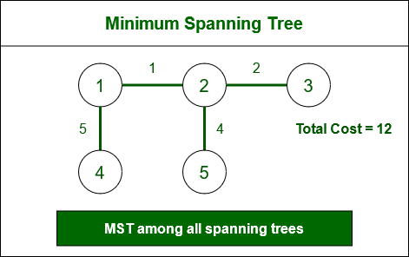

Slide 45
Prims Algorithm
1.This is a famous greedy algorithm
2.It is used for finding Minimum Spanning Tree of a given graph.
3.To apply Prim's Algorithm,the given graph must me weighted, undirected and
Connected.
4.find subset of edges that includes every vertex of the graph such that the sum of the weights of the edges that can be minimized.
5.The edges with the minimal weights causing no cycles in the graph got selected.
6.Time complexity is O(E+log V)

Slide 46
Prims Algorithm Implementation
Step 1:
a.Randomly choose any vertex
b. The vertex connecting with least edge is selected
Step 2:
a.Find all the edges that connect the tree to new vertices
b.Find the least weight edge among those edges and include in the tree
c.If including that edge creates a cycle, then reject that edge and look for the next least weight edge.
Step 3 :
Keep repeating step 2 until all the vertices are included and Minimum spanning tree is obtained.

Slide 47
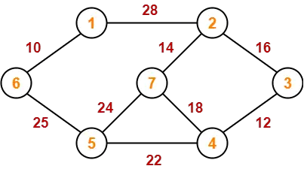
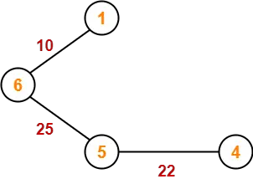
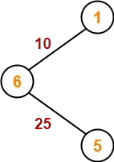
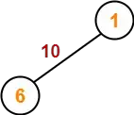
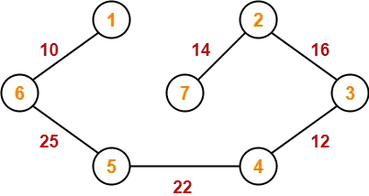
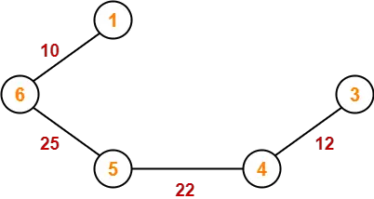
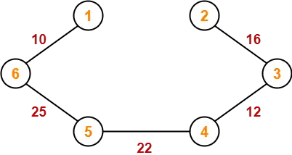
=Sum of all edges = 99 units

Slide 48
Kruskal’s Algorithm
1.This is a famous greedy algorithm
2.It is used for finding Minimum Spanning Tree of a given graph.
3.To apply Kruskal's Algorithm,the given graph must me weighted, undirected and
Connected.
4.find subset of edges that by using which we can traverse every vertex of the graph.
5.It finds optimum solution at every stage.The edges with the minimal weights causing no cycles in the graph should not be considered.
6.Time complexity is O(Elog V)

Slide 49
Kruskal's Algorithm Implementation
Step 1:
A.sort all the edges from low to high weight
Step 2:
a.Take the edge of the lowest weight and use it to connect vertices with the graph
b.Find the least weight edge among those edges and include in the tree
c.If adding that edge creates a cycle, then reject that edge and look for the next least weight edge.
Step 3 :
Keep adding edges until all the vertices are connected and Minimum spanning tree is obtained.

Slide 50
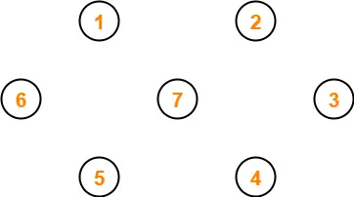
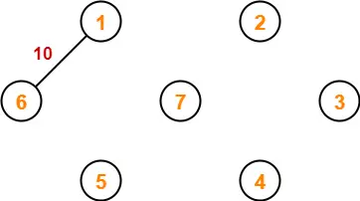
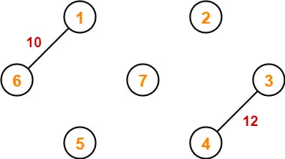

Slide 51
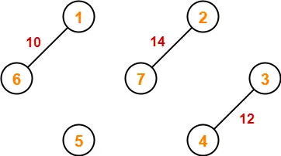
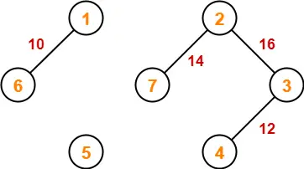
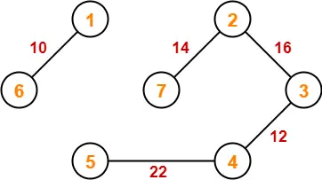
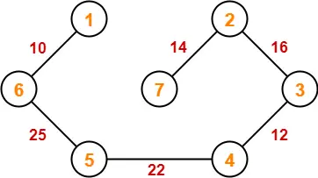
= sum of all the edges = 99 units

Slide 52
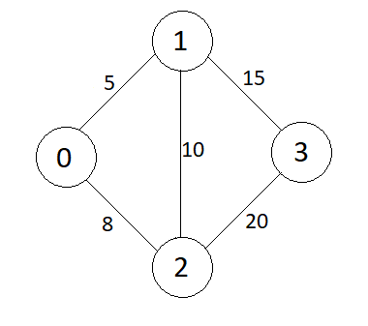
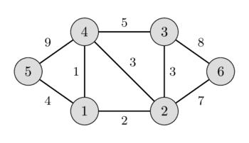
Problem :

Slide 53
Case Study - Ride sharing App
1.Finding the closest driver to a rider
2. Optimizing road networks dynamically
3.Long-term city-wide ride-sharing network design
4.Minimizing driver-rider connection time
5.Reducing overall surge pricing

Slide 54
Case Study - Ride sharing App
Finding the closest driver to a rider
Prim’s Algorithm: ✅ Yes – If the problem is modeled as a graph where drivers and riders are nodes, Prim’s can be used to build a minimal connection network from the rider.
Kruskal’s Algorithm: ❌ No – Kruskal’s focuses on globally minimizing the sum of all edge weights, which isn’t useful for a localized nearest-driver search.
Optimizing road networks dynamically
Prim’s Algorithm: ✅ Yes – Can help in dynamically constructing an optimal road network for real-time updates.
Kruskal’s Algorithm: ❌ No – Since Kruskal’s works on sorting and merging edges, it is less suited for dynamic real-time updates.
Long-term city-wide ride-sharing network design
Prim’s Algorithm: ❌ No – Works best for local optimization rather than city-wide planning.
Kruskal’s Algorithm: ✅ Yes – Ideal for minimizing overall connection costs in a large-scale transportation network.
Minimizing driver-rider connection time
Prim’s Algorithm: ✅ Yes – Can help in dynamically connecting riders to nearby drivers with minimal connection time.
Kruskal’s Algorithm: ❌ No – Doesn’t prioritize individual connections.
Reducing overall surge pricing
Prim’s Algorithm: ❌ No – Focuses on local optimization rather than balancing supply-demand over a city.
Kruskal’s Algorithm: ✅ Yes – Helps in structuring efficient city-wide ride-sharing networks, reducing congestion and demand spikes.

Slide 55
Dynamic Programming
•Dynamic Programming (DP) is an optimization technique used in algorithms to solve problems by breaking them down into overlapping subproblems and storing their solutions to avoid redundant computations.
It is particularly useful for problems that exhibit optimal substructure (i.e., an optimal solution can be built from optimal solutions of subproblems) and overlapping subproblems (i.e., the same subproblems are solved multiple times).

Slide 56
Problem Fibonacci series
Optimal Substructure
Optimal substructure means an optimal solution can be constructed from optimal solutions of its subproblems.
Overlapping Subproblems
Subproblems are smaller versions of the original problem. Any problem has overlapping sub-problems if finding its solution involves solving the same subproblem multiple times.
fib(n) = fib(n-1) + fib(n-2)

Slide 57
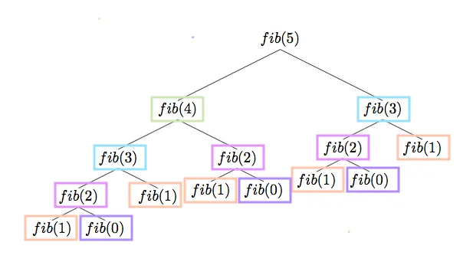

Slide 58
0/1 Knapsack Problem
The 0/1 Knapsack Problem is a classic Dynamic Programming problem where you have a set of items, each with a weight and a value, and a knapsack with a weight capacity. The goal is to determine the maximum value that can be obtained by selecting items, ensuring that the total weight does not exceed the knapsack capacity.
Each item can either be included (1) or excluded (0)—hence the name 0/1 Knapsack.

Slide 59
Problem 1
Weight (W) ={3,4,6,5} Profit (P) = {2,3,1,4} ;Total weight = 8 kg total items = 4
p | w | i | 0 | 1 | 2 | 3 | 4 | 5 | 6 | 7 | 8
 |  | 0
2 | 3 | 1
3 | 4 | 2
4 | 5 | 3
1 | 6 | 4

Slide 60
Problem 1
Weight (W) ={3,4,6,5} Profit (P) = {2,3,1,4} ;Total weight = 8 kg total items = 4
p | w | i | 0 | 1 | 2 | 3 | 4 | 5 | 6 | 7 | 8
 |  | 0 | 0 | 0 | 0 | 0 | 0 | 0 | 0 | 0 | 0
2 | 3 | 1 | 0
3 | 4 | 2 | 0
4 | 5 | 3 | 0
1 | 6 | 4 | 0

Slide 61
Problem 1
Weight (W) ={3,4,6,5} Profit (P) = {2,3,1,4} ;Total weight = 8 kg total items = 4
p | w | i | 0 | 1 | 2 | 3 | 4 | 5 | 6 | 7 | 8
 |  | 0 | 0 | 0 | 0 | 0 | 0 | 0 | 0 | 0 | 0
2 | 3 | 1 | 0 | 0 | 0 | 2 | 2 | 2 | 2 | 2 | 2
3 | 4 | 2 | 0
4 | 5 | 3 | 0
1 | 6 | 4 | 0

Slide 62
Problem 1
Weight (W) ={3,4,6,5} Profit (P) = {2,3,1,4} ;Total weight = 8 kg total items = 4
Profit Max (3 + 0(0 th col, top most value) ,2 (immediate top value)) -> Max(3,2) ->3
4(i)-4(w)=0
p | w | i | 0 | 1 | 2 | 3 | 4 | 5 | 6 | 7 | 8
 |  | 0 | 0 | 0 | 0 | 0 | 0 | 0 | 0 | 0 | 0
2 | 3 | 1 | 0 | 0 | 0 | 2 | 2 | 2 | 2 | 2 | 2
3 | 4 | 2 | 0 | 0 | 0 | 2
4 | 5 | 3 | 0
1 | 6 | 4 | 0

Slide 63
Problem 1
Weight (W) ={3,4,6,5} Profit (P) = {2,3,1,4} ;Total weight = 8 kg total items = 4
Profit Max (3 + 0(0 th col, value) ,2 (immediate top value)) -> Max(3,2) ->3
4(i)-4(w)=0
p | w | i | 0 | 1 | 2 | 3 | 4 | 5 | 6 | 7 | 8
 |  | 0 | 0 | 0 | 0 | 0 | 0 | 0 | 0 | 0 | 0
2 | 3 | 1 | 0 | 0 | 0 | 2 | 2 | 2 | 2 | 2 | 2
3 | 4 | 2 | 0 | 0 | 0 | 2 | 3
4 | 5 | 3 | 0
1 | 6 | 4 | 0

Slide 64
Problem 1
Weight (W) ={3,4,6,5} Profit (P) = {2,3,1,4} ;Total weight = 8 kg total items = 4
Profit Max (3 + 0 (1st col, value) ,2 (immediate top value)) -> Max(3,2) ->3
5(i)-4(w)=1
p | w | i | 0 | 1 | 2 | 3 | 4 | 5 | 6 | 7 | 8
 |  | 0 | 0 | 0 | 0 | 0 | 0 | 0 | 0 | 0 | 0
2 | 3 | 1 | 0 | 0 | 0 | 2 | 2 | 2 | 2 | 2 | 2
3 | 4 | 2 | 0 | 0 | 0 | 2 | 3
4 | 5 | 3 | 0
1 | 6 | 4 | 0

Slide 65
Problem 1
Weight (W) ={3,4,6,5} Profit (P) = {2,3,1,4} ;Total weight = 8 kg total items = 4
Profit Max (3 + 0 (1st col, value) ,2 (immediate top value)) -> Max(3,2) ->3
5(i)-4(w)=1
p | w | i | 0 | 1 | 2 | 3 | 4 | 5 | 6 | 7 | 8
 |  | 0 | 0 | 0 | 0 | 0 | 0 | 0 | 0 | 0 | 0
2 | 3 | 1 | 0 | 0 | 0 | 2 | 2 | 2 | 2 | 2 | 2
3 | 4 | 2 | 0 | 0 | 0 | 2 | 3 | 3
4 | 5 | 3 | 0
1 | 6 | 4 | 0

Slide 66
Problem 1
Weight (W) ={3,4,6,5} Profit (P) = {2,3,1,4} ;Total weight = 8 kg total items = 4
Profit Max (3 + 0 (2nd col, value) ,2 (immediate top value)) -> Max(3,2) ->3
6(i)-4(w)=2
p | w | i | 0 | 1 | 2 | 3 | 4 | 5 | 6 | 7 | 8
 |  | 0 | 0 | 0 | 0 | 0 | 0 | 0 | 0 | 0 | 0
2 | 3 | 1 | 0 | 0 | 0 | 2 | 2 | 2 | 2 | 2 | 2
3 | 4 | 2 | 0 | 0 | 0 | 2 | 3 | 3
4 | 5 | 3 | 0
1 | 6 | 4 | 0

Slide 67
Problem 1
Weight (W) ={3,4,6,5} Profit (P) = {2,3,1,4} ;Total weight = 8 kg total items = 4
Profit Max (3 + 0 (2nd col, value) ,2 (immediate top value)) -> Max(3,2) ->3
6(i)-4(w)=2
p | w | i | 0 | 1 | 2 | 3 | 4 | 5 | 6 | 7 | 8
 |  | 0 | 0 | 0 | 0 | 0 | 0 | 0 | 0 | 0 | 0
2 | 3 | 1 | 0 | 0 | 0 | 2 | 2 | 2 | 2 | 2 | 2
3 | 4 | 2 | 0 | 0 | 0 | 2 | 3 | 3 | 3
4 | 5 | 3 | 0
1 | 6 | 4 | 0

Slide 68
Problem 1
Weight (W) ={3,4,6,5} Profit (P) = {2,3,1,4} ;Total weight = 8 kg total items = 4
Profit Max (3 + 2(3rd col, value) ,2 (immediate top value)) -> Max(5,2) ->5
7(i)-4(w)=3
p | w | i | 0 | 1 | 2 | 3 | 4 | 5 | 6 | 7 | 8
 |  | 0 | 0 | 0 | 0 | 0 | 0 | 0 | 0 | 0 | 0
2 | 3 | 1 | 0 | 0 | 0 | 2 | 2 | 2 | 2 | 2 | 2
3 | 4 | 2 | 0 | 0 | 0 | 2 | 3 | 3 | 3
4 | 5 | 3 | 0
1 | 6 | 4 | 0

Slide 69
Problem 1
Weight (W) ={3,4,6,5} Profit (P) = {2,3,1,4} ;Total weight = 8 kg total items = 4
Profit Max (3 + 2(3rd col, value) ,2 (immediate top value)) -> Max(5,2) ->5
7(i)-4(w)=3
p | w | i | 0 | 1 | 2 | 3 | 4 | 5 | 6 | 7 | 8
 |  | 0 | 0 | 0 | 0 | 0 | 0 | 0 | 0 | 0 | 0
2 | 3 | 1 | 0 | 0 | 0 | 2 | 2 | 2 | 2 | 2 | 2
3 | 4 | 2 | 0 | 0 | 0 | 2 | 3 | 3 | 3 | 5
4 | 5 | 3 | 0
1 | 6 | 4 | 0

Slide 70
Problem 1
Weight (W) ={3,4,6,5} Profit (P) = {2,3,1,4} ;Total weight = 8 kg total items = 4
Profit Max (3 + 2(4th col, value) ,2 (immediate top value)) -> Max(5,2) ->5
8(i)-4(w)=4
p | w | i | 0 | 1 | 2 | 3 | 4 | 5 | 6 | 7 | 8
 |  | 0 | 0 | 0 | 0 | 0 | 0 | 0 | 0 | 0 | 0
2 | 3 | 1 | 0 | 0 | 0 | 2 | 2 | 2 | 2 | 2 | 2
3 | 4 | 2 | 0 | 0 | 0 | 2 | 3 | 3 | 3 | 5
4 | 5 | 3 | 0
1 | 6 | 4 | 0

Slide 71
Problem 1
Weight (W) ={3,4,6,5} Profit (P) = {2,3,1,4} ;Total weight = 8 kg total items = 4
Profit Max (3 + 2(4th col, value) ,2 (immediate top value)) -> Max(5,2) ->5
8(i)-4(w)=4
p | w | i | 0 | 1 | 2 | 3 | 4 | 5 | 6 | 7 | 8
 |  | 0 | 0 | 0 | 0 | 0 | 0 | 0 | 0 | 0 | 0
2 | 3 | 1 | 0 | 0 | 0 | 2 | 2 | 2 | 2 | 2 | 2
3 | 4 | 2 | 0 | 0 | 0 | 2 | 3 | 3 | 3 | 5 | 5
4 | 5 | 3 | 0
1 | 6 | 4 | 0

Slide 72
Problem 1
Weight (W) ={3,4,6,5} Profit (P) = {2,3,1,4} ;Total weight = 8 kg total items = 4
Profit Max (3 + 2(4th col, value) ,2 (immediate top value)) -> Max(5,2) ->5
8(i)-4(w)=4
p | w | i | 0 | 1 | 2 | 3 | 4 | 5 | 6 | 7 | 8
 |  | 0 | 0 | 0 | 0 | 0 | 0 | 0 | 0 | 0 | 0
2 | 3 | 1 | 0 | 0 | 0 | 2 | 2 | 2 | 2 | 2 | 2
3 | 4 | 2 | 0 | 0 | 0 | 2 | 3 | 3 | 3 | 5 | 5
4 | 5 | 3 | 0 | 0 | 0 | 2 | 3
1 | 6 | 4 | 0

Slide 73
Problem 1
Weight (W) ={3,4,6,5} Profit (P) = {2,3,1,4} ;Total weight = 8 kg total items = 4
Profit Max (3 + 2(4th col, value) ,2 (immediate top value)) -> Max(5,2) ->5
8(i)-4(w)=4
p | w | i | 0 | 1 | 2 | 3 | 4 | 5 | 6 | 7 | 8
 |  | 0 | 0 | 0 | 0 | 0 | 0 | 0 | 0 | 0 | 0
2 | 3 | 1 | 0 | 0 | 0 | 2 | 2 | 2 | 2 | 2 | 2
3 | 4 | 2 | 0 | 0 | 0 | 2 | 3 | 3 | 3 | 5 | 5
4 | 5 | 3 | 0 | 0 | 0 | 2 | 3 | 4 | 4 | 5 | 6
1 | 6 | 4 | 0 | 0 | 0 | 2 | 3 | 4 | 4 | 5 | 6

Slide 74
Problem 2
Profit ={1,2,5,6}
weight = {2,3,4,5}
Total weight = 8,
n =4

Slide 75
Problem 2
Profit ={1,2,5,6} weight = {2,3,4,5} Total weight = 8, n =4
p | w | i | 0 | 1 | 2 | 3 | 4 | 5 | 6 | 7 | 8
 |  | 0 | 0 | 0 | 0 | 0 | 0 | 0 | 0 | 0 | 0
1 | 2 | 1 | 0 | 0 | 1 | 1 | 1 | 1 | 1 | 1 | 1
2 | 3 | 2 | 0 | 0 | 1 | 2 | 2 | 3 | 3 | 3 | 3
5 | 4 | 3 | 0 | 0 | 1 | 2 | 5 | 5 | 6 | 7 | 7
6 | 5 | 4 | 0 | 0 | 1 | 2 | 5 | 6 | 6 | 7 | 8

Slide 76
Problem 3
Profits (P) = {3, 4, 8, 6} ,
Weights (W) = {2, 3, 5, 7}
Knapsack Capacity (C) = 10 kg ,
Number of Items (n) = 4

Slide 77
Problem 3
Profits (P) = {3, 4, 8, 6} ,Weights (W) = {2, 3, 5, 7} ,Knapsack Capacity (C) = 10 kg ,Number of Items (n) = 4
p | w | i | 0 | 1 | 2 | 3 | 4 | 5 | 6 | 7 | 8 | 9 | 10
 |  | 0 | 0 | 0 | 0 | 0 | 0 | 0 | 0 | 0 | 0 | 0 | 0
3 | 2 | 1 | 0 | 0 | 3 | 3 | 3 | 3 | 3 | 3 | 3 | 3 | 3
4 | 3 | 2 | 0 | 0 | 3 | 4 | 4 | 7 | 7 | 7 | 7 | 7 | 7
8 | 5 | 3 | 0 | 0 | 3 | 4 | 4 | 7 | 7 | 9 | 10 | 10 | 13
6 | 7 | 4 | 0 | 0 | 3 | 4 | 4 | 7 | 7 | 9 | 10 | 11 | 13

Slide 78
Problem 4
Profits (P) = {5, 6, 3, 7}
Weights (W) = {3, 5, 2, 6}
Knapsack Capacity (C) = 12 kg
Number of Items (n) = 4

Slide 79
Problem 4
p | w | i | 0 | 1 | 2 | 3 | 4 | 5 | 6 | 7 | 8 | 9 | 10 | 11 | 12
 |  | 0 | 0 | 0 | 0 | 0 | 0 | 0 | 0 | 0 | 0 | 0 | 0 | 0 | 0
5 | 3 | 0 | 0 | 0 | 5 | 5 | 5 | 5 | 5 | 5 | 5 | 5 | 5 | 5 | 5
6 | 5 | 0 | 0 | 0 | 5 | 5 | 6 | 6 | 6 | 6 | 11 | 11 | 11 | 11 | 11
3 | 2 | 0 | 0 | 3 | 5 | 5 | 6 | 8 | 8 | 8 | 11 | 11 | 14 | 14 | 14
7 | 6 | 0 | 0 | 3 | 5 | 5 | 6 | 8 | 8 | 8 | 11 | 12 | 14 | 15 | 15

Slide 80
Applications of Matrix Chain Applications
Computer Graphics & Image Processing – Efficiently applies transformations.
Compiler Optimization – Optimizes expression evaluation and parsing.
Database Query Optimization – Determines the best join order for queries.
Machine Learning & Deep Learning – Optimizes neural network computations.
Robotics & CAD – Efficiently computes transformations for motion planning.
Network Routing – Optimizes data transmission and error correction.
Bioinformatics – Enhances DNA sequence alignment and phylogenetics.
Cryptography – Improves encryption algorithms and secure computations.

Slide 81
Real-Time Applications of Matrix Chain Multiplication (MCM) in Stock Market
Portfolio Optimization – Efficiently processes large financial matrices to find the best asset allocation with minimal risk.
High-Frequency Trading (HFT) – Speeds up real-time decision-making for algorithmic trading by optimizing matrix operations in predictive models.
Risk Management & Market Forecasting – Enhances financial models (e.g., Monte Carlo simulations) to predict stock price fluctuations.
Correlation Analysis – Helps in identifying relationships between multiple stocks by efficiently computing covariance matrices.
Sentiment Analysis for Market Trends – Improves NLP-based stock sentiment analysis by optimizing deep learning computations.
Option Pricing Models (Black-Scholes, Binomial Trees) – Speeds up complex mathematical computations required for derivative pricing.
Fraud Detection & Anomaly Detection – Optimizes real-time fraud analysis by processing large transaction datasets efficiently.
Stock Market Data Compression – Enhances real-time data transmission and storage using optimized matrix multiplications.
Quantitative Finance Models – Speeds up real-time computations in factor models (e.g., CAPM, Fama-French).
Hedge Fund Strategy Optimization – Helps funds process large-scale matrix computations to analyze market patterns in real-time.

Slide 82
Longest common subsequence
1.ABCD
Substring - AB, BC , CD ,ABC,BCD
Subsequence - AD ,BD,AC,ACD,ABC DC ,BA
2. X: A B C D H F
Y: A E D F K AD,DF,AF,ADF
3. X: A G G T A B
Y: G X T X A Y B GTAB

Slide 83
Longest Common Subsequence
Applications :
Bioinformatics – DNA/protein sequence alignment and evolutionary studies.
Plagiarism Detection – Identifies similarities in text and code.
Data Compression – Used in diff and rsync for file comparison.
Spell Checking & NLP – Improves text correction and autocomplete.
Version Control (Git, SVN) – Tracks code changes efficiently.
Speech & OCR Recognition – Enhances text matching accuracy.
Database & Search Optimization – Improves query result ranking.
Computational Biology – Helps in genome sequencing and phylogenetics.

Slide 84
Refer the uploaded pdf. on moodle for following topics
1.Matrix chain Multiplication
2. Longest common Subsequence

Slide 85
Problems on MCM and LCS
A1 (10 ×30) , A2 (30× 5 ), A3 ( 5× 60)
A1​(40×20) , A2​(20×30) , A3​(30×10) , A4​(10×30)
X = "AGGTAB" Y = "GTXTYB"
X = "ABCBDAB" Y = "BDCAB"
X = "ACDBE" Y = "ABCDE"

